Slide 1
NAME BINDING AND OBJECT LIFETIMES
Programming Languages
Lecture 10
Adeesha Wijayasiri

Slide 2
TOPICS COVERED
Concept of Names
The Notion of Binding Time
Storage Management Mechanisms
Parameter Passing Methods

Slide 3
LEARNING OUTCOMES
After completing this module, students should be able to
explain the concepts of names and binding names to objects in programming languages
explain the notion of binding time in programming languages
explain the storage management mechanisms that can be used for objects which have different lifetimes

Slide 4
NAMES
Pervasive in programming languages.
Not limited to identifiers ('+' is a name)
– Refer to variables, constants, operations, types, files, functions, procedures, modules, etc.
Must be tracked in any compiler, usually in a symbol table.
– Must verify proper usage of names, e.g.
a+b (types of a,b OK ?)
f(a) (is f a declared function ?, type of a OK ?

Slide 5
NAME BINDING
Association between a name and the object its represents.
The term "object" denotes an entity or concept in the language.
Examples:
In RPAL, let X=3 in …
In C, int n;
In C++, class stack { … }

Slide 6
VARIOUS TIMES FOR BINDING
Language design time, e.g. name int.
Language implementation time, e.g float.
Program writing time. Names of variables, data structures, modules.
– Example: names of debugging flags for C preprocessor:
#define DEBUGGING 1
... #if DEBUGGING
printf( ... );
#endif

Slide 7
VARIOUS TIMES FOR BINDING
Compile time: most bindings take place here.
– int n;
Link time: modules compiled separately are linked together, inter-module references resolved.
– Example: location of library functions.
Load time:
– program given a load point,
– translate virtual memory addresses into physical memory addresses.

Slide 8
VARIOUS TIMES FOR BINDING
Run time. Variables bound to values (memory allocated).
Sub-categories include:
program start-up time,
module entry time,
elaboration time (allocate memory for a declared variable),
execution time.

Slide 9
TERMINOLOGY
Static usually means "before run time".
Dynamic usually refers to run time.
Tradeoff: In general,
Early binding -> greater efficiency, less flexibility.
Late binding -> more flexibility, less efficiency.

Slide 10
EARLY VS. LATE BINDING
Early binding:
Most compiled implementations: C, C++, Java.
Compilers analyze semantics, allocate memory in advance, generate smarter code.
Can't predict location of a local variable at run time.
Can arrange for a variable to live at a fixed offset from a run-time register.
Late Binding:
most interpreted languages, e.g. RPAL, BASIC, perl, shell script languages, Smalltalk.
More analysis done at run time, less efficient.

Slide 11
BINDINGS IN DECLARATIONS
Declaration: Binds name with a “descriptor”: information about type, value, address, etc. For example:
const x=7;
Binds x to (7,type integer).
var x:integer;
Binds x to (address, type integer), if global Binds x to (stack offset, type integer), if local
type T = record
y: integer; x: real;
end;
Binds y to (record offset, type integer). Binds x to (record offset, type real) Binds T to (is_record_type, list of fields)

Slide 12
OBJECT LIFETIME AND STORAGE MANAGEMENT
Issues:
Object creation.
Binding creation.
Name references (binding usages).
Activation, deactivation, reactivation of bindings. (mostly due to scope rules).
Binding destruction.
Object destruction.

Slide 13
DEFINITIONS
Binding Lifetime:
Period of time between creation and destruction of a binding.
Object lifetime:
Period of time between creation and destruction of an object.
Binding lifetime usually shorter than object lifetime.

Slide 14
EXAMPLE: PASSING A VARIABLE BY REFERENCE
main() {
int n=3; | // | object n exists
f(&n); | // | throughout, but ...
}
void f(int * p) {
*p | = | 4;
// |  | binding | of | p | is | temporary
}

Slide 15
BINDING DESTRUCTION CAN BE TROUBLE
Example: (classic no-no in C)
int *f() { int p; return(&p);
// binding of p is destroyed,
// but the object (address) still exists.
}

Slide 16
BINDING LIFETIME > OBJECT LIFETIME
Example (in C):
char *p = malloc(4); strcpy(p, "abc");
free(p); // object gone, but
// binding of p, to a
// useless address, lives on. strcpy(p, "abc");
// Bad things can happen.
Called a dangling reference: binding of a name to an object that no longer exists.

Slide 17
STORAGE ALLOCATION MECHANISMS

Slide 18
STORAGE ALLOCATION MECHANISMS
Three main storage allocation mechanisms: 1.Static allocation.
Objects retain absolute address throughout.
Examples: global variables.
Stack-based allocation:
Object addresses relative to a stack (segment) base, usually in conjunction with fcn/proc calls.
Heap-based allocation. Objects allocated and deallocated at programmer's discretion.
We’ll discuss each in turn.

Slide 19
STATIC ALLOCATION
Special case: No recursion.
Original Fortran, most BASICs.
Variables local to procedures allocated statically, not on a stack. Procedures can share their local variables !
No more since Fortran 90.

Slide 20
STACK-BASED ALLOCATION
Necessary to implement recursion.
Storage is allocated/deallocated/managed on a stack.
Each subroutine that is called gets a stack frame/activation record on top of the stack.
A frame contains:
Arguments that are passed into the subroutine.
Bookkeeping info (caller return address).
Local variables / temporaries.
Frame organization varies by language and implementation.

Slide 21
FRAME MANAGEMENT
Responsibility shared between caller and callee:
Prologue (caller): Push arguments and return address onto stack, save return address, change program counter, change SP, save registers, jump to target.
During function (callee): make space for local variables, do the work, jump to saved return address.
Epilogue (caller): Remove return address and parameters from the stack, store SP, restore registers, and continue.)
Calling sequence varies by processor, and by compiler.

Slide 22
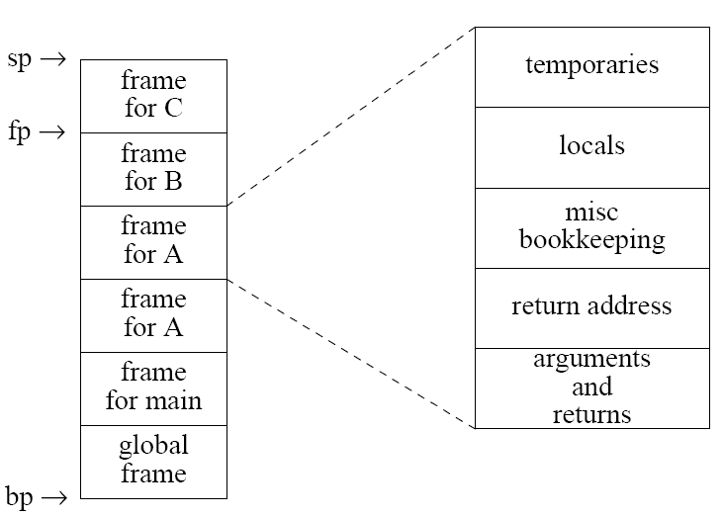
FRAME MANAGEMENT – GENERAL SCHEME
int g;
main()
{A();}
fcn A()
{A();
B();}
proc B()
{C();}
proc C()
{}
bp: Base pointer: global references. fp: Frame pointer: local references. sp: Stack pointer: Top of stack.

Slide 23
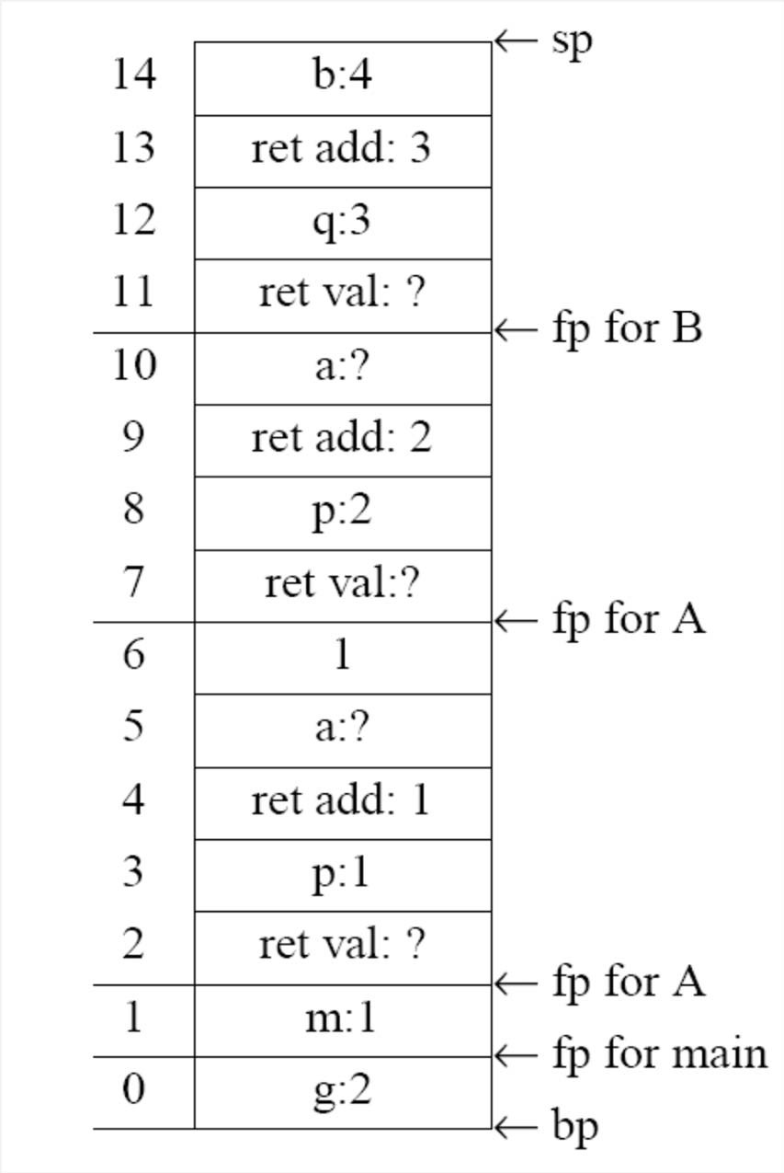
SAMPLE FRAME MANAGEMENT
int g=2;
main() {
int m=1;
print(A(m));
}
int A(int p) {
int a;
if p=1
return 1+A(2);
else
return B(p+1);
}
int B(int q) {
int b=4;
print(q+b+g);
}
//g: bp+0
//m: fp+0
//ret add 1
//p: fp+1
//a: fp+3
//ret add 2
//ret add 3
//q: fp+1
//b: fp+3

Slide 24
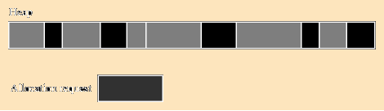
HEAP-BASED ALLOCATION
Heap: Memory market. ☺
Memory region where memory blocks can be bought and sold (allocated and deallocated).
Many strategies for managing the heap.
Main problem: fragmentation.
After many allocations and deallocations, many small free blocks scattered and intermingled with used blocks.
Heap
Allocation request

Slide 25
HEAP-BASED ALLOCATION
Allocation is usually explicit in PL's:
malloc, new.
Strategies for fragmentation:
Compaction. Expensive.
Internal fragmentation:
Allocate larger block than needed. Space wasted.
External fragmentation:
Can't handle a request for a large block. Plenty of free space, but no large blocks available.

Slide 26
EXTERNAL FRAGMENTATION
Use a linked list of free blocks.
First fit strategy: allocate first block that suffices. More efficient, but more fragmentation.
Best fit strategy: allocate smallest block that suffices. Less efficient, less fragmentation.
Maintain "pools" of blocks, of various sizes.
"Buddy system": blocks of size 2^{k}. Allocate blocks of nearest power of two. If none available, split up one of size 2^{k+1}. When freed later, "buddy it" back, if possible.
Fibonacci heap: Use block sizes that increase as Fibonacci numbers do: f(n)=f(n-1)+f(n-2), instead of doubling.

Slide 27
HEAP DEALLOCATION
Implicit: Garbage Collection (Java).
Automatic, but expensive (getting better).
Explicit: free (C, C++), dispose (Pascal).
Risky.
Very costly errors, memory leaks, but efficient.

Slide 28
PARAMETER PASSING

Slide 29
PARAMETER PASSING
Some languages allow only ONE parameter passing mode:
C, Fortran, ML, Lisp, Java.
Other languages allow multiple parameter passing modes:
Pascal, Modula, Ada.

Slide 30
PARAMETER PASSING MODES
Call by value: Pass the value of the argument.
C, C++, Pascal, Java, RPAL.
Call by reference: Pass the address of the argument.
Smalltalk, Lisp, ML, Clu, C++, Pascal.
Call by result: Pass the value, on return only.
Ada.
Call by value-result: Pass the value (a.k.a. copy-in, copy-out)
Ada.

Slide 31
CHOOSING PARAMETER PASSING MODE
Many languages provide a choice:
Pass by value:
Intent is to not modify the argument.
Copying large objects can get expensive.
Pass by reference:
Intent is to modify the argument.
Often used to avoid copying a large object, even if there’s no intent to modify it.
In some languages (C, C++) modifying the argument can be explicitly forbidden (const)

Slide 32
PARAMETER PASSING MODES: EXAMPLE
Pass by value:
var y:integer; procedure
A(x:integer);
begin
write(x); x := 1;
write(y+x);
end; begin
y := 5; A(y);
write(y); end;
Notes:
Output is :(5,6,5)

Slide 33
PARAMETER PASSING MODES: EXAMPLE
Pass by reference:
var y:integer; procedure
A(x:integer);
begin
write(x); x := 1;
write(y+x);
end; begin
y := 5; A(y);
write(y); end;
Notes:
Output is :(5,2,1)

Slide 34
PARAMETER PASSING MODES: EXAMPLE
Pass by result:
var y:integer; procedure
A(x:integer);
begin
write(x); x := 1;
write(y+x);
end; begin
y := 5; A(y);
write(y); end;
Notes:
Output is:(??,6,1)

Slide 35
PARAMETER PASSING MODES: EXAMPLE
Pass by value/result:
var y:integer; procedure
A(x:integer);
begin
write(x); x := 1;
write(y+x);
end; begin
y := 5; A(y);
write(y); end;
Notes:
Output is :(5,6,1)

Slide 36
PARAMETER PASSING MODES: EXAMPLE
Pass by name:
var y:integer; procedure
A(x:integer);
begin
write(x); x := 1;
write(y+x);
end; begin
y := 5; A(y);
write(y); end;
Notes:
Output is :(5,2,1)

Slide 37
PASS BY NAME
Pass by name literally substitutes n for a, and m for b.
Result: t := n;
n := m;
m := t;
Swap is achieved.
procedure swap(a,b:integer); var t:integer:
begin
t := a:
:= b:
:= t; end;
...
var n,m:integer; n := 3;
m := 4;
swap(n,m);

Slide 38
PASS BY NAME
However, attempting to swap i and A[i] results in
t := i;
i := A[i];
A[i] := t;
17 assigned to i, but 3 assigned to A[17] (out of range)
Swap not achieved.
procedure swap(a,b:integer); var t:integer:
begin
t := a:
:= b:
:= t; end;
...
var i:integer;
var A: array[1..10] of integer; i := 3;
A[3] := 17;
swap(i,A[i]);

Slide 39
PARAMETER PASSING IN PASCAL
var y:integer;
procedure A(var x:integer); begin
write(x);
x := 1;
write(y+x);
end; begin
y := 5; A(y);
write(y); end;
Use keyword var to effect pass by reference. Without var, it’s pass by value.
With var , output is (5,2,1).
Without var, output is (5,6,5).

Slide 40
PARAMETER PASSING IN C
All parameters passed by value.
However, can use pointers (which are passed by value):
void swap (int *a, int *b) { int t;
t = *a;
*a = *b;
*b = t;
}
...
swap(&p,&q);

Slide 41
PARAMETER PASSING IN C++
C++ has pass by value and by reference.
Use the & prefix for pass by reference.
void swap (int &a, int &b) { int t;
t = a; a = b; b = t;
}
swap (p,q);
Parameters can be declared const.

Slide 42
PARAMETER PASSING IN JAVA
“primitives passed by value, non-primitives passed by reference”. NOT true. All parameters passed by value in Java.
A primitive (int, float, etc.) has no reference, so the value is passed.
public void swap (int a, int b) { int t;
t = a; a = b; b = t;
}
int p=3; q=4;
swap(p,q); // no swap achieved.

Slide 43
PARAMETER PASSING IN JAVA
Non-primitives are handled by reference, so any reference is passed by value.
Not the same as pass by reference.
public void tricky(Point a, Point b) { a.x = 100; a.y = 100;
Point temp; temp = a; a = b; b = temp;
}
public static void main(String [] args) {
Point x = new Point(0,0); Point y = new Point(0,0); tricky(x,y);
}
tricky changes a, but swap is not achieved.

Slide 44
Thank You!

Slide 45
References
Programming Language Pragmatics by Michael L. Scott. 3rd edition. Morgan Kaufmann Publishers. (April 2009).
Lecture Slides of Dr.Malaka Walpola and Dr.Bermudez

